Slide 1
Café Conundrum
An Analysis of Geographical Expansion Options for Independent Coffee Shop Owners in Marlow

Slide 2
Background
Marlow is a thriving market town in Buckinghamshire
Lots of coffee shops for the town and weekend visitors
No room for expansion in Marlow
Where are the best local towns for expansion?
Let’s find out...

Slide 3
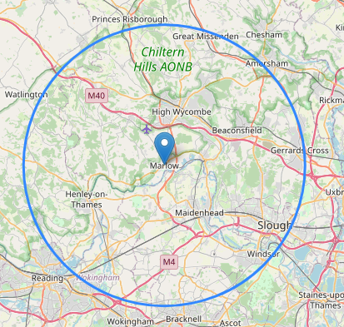
What’s our catchment…?
Within ten miles of Marlow...
The following towns:
Cookham
Maidenhead
Henley
Twyford
High Wycombe
Beaconsfield
Amersham
Bourne End
Gerrards Cross
Slough
Windsor

Slide 4
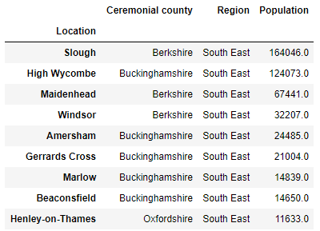
What about size?
Some of these candidate towns are significantly bigger than Marlow and would not constitute a like-for-like comparison.
With that in mind, Slough, High Wycombe and Maidenhead were disqualified.

Slide 5
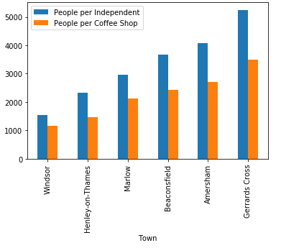
Coffee shop density
Joining the population data with venue data gives the following picture for total and independent coffee shops...
Those to the right of Marlow on the bar chart have less coffee shops per person and could be good candidates for geographical expansion.

Slide 6
Other considerations
Planning and Availability - the candidate towns may have planning constraints and a lack of availability that would disqualify them as candidates.
Ratings - understand the quality as well as the density of competition. There may be significantly weaker competition in one of the better served towns.
Largers Towns - there may be justification for further investigation in the larger towns that were excluded.
Demographics - the demographics of the candidate towns may be completely different which may have an effect on demand.

Slide 7
Conclusion
Data suggests three options for further exploration - Gerrards Cross, Amersham and Beaconsfield.
Recommend visiting those towns to gain a feel for the location and the prospective competition.
If there are no obvious candidates, investigate the larger towns and/or broaden the net to include some more candidates further afield.

